Slide 1
C++ Programming:
Problem Solving and Programming
Chapter 12
Structure (Record)

Slide 2
Objectives
In this chapter you will:
Learn about records (structs)
Examine various operations on a struct
Explore ways to manipulate data using a struct
Learn about the relationship between a struct and functions
Discover how arrays are used in a struct
Learn how to create an array of struct items

Slide 3
Records/Structure (structs)
Struct: collection of a fixed number of components, accessed by a single name
Components may be of different types
Components of a struct are called the members
struct is a reserved word

Slide 4
Records (structs)
The general syntax of struct is:
struct structName
{
DataType 1 Identifier 1;
DataType 2 Identifier 2;
.
.
.
DataType n Identifier n;
};

Slide 5
Records (structs) - Example
struct studentType
{
char firstName[10];
char lastName[10];
char courseGrade;
int testScore;
int programmingScore;
double GPA;
};
studentType newStudent, student;
Define a
Structure / Record
Declare 2
Structure variables

Slide 6
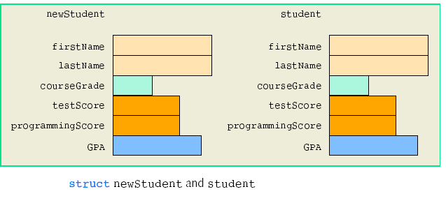
Records (structs) - Example

Slide 7
Accessing struct Members
The syntax for accessing a struct member is:
structVariable_Name.member_Name
The dot (.) is an operator, called the member access operator

Slide 8
Accessing struct Members - Example
// Assign “Dennis” to newStudent first name
strcpy (newStudent .firstName, “Dennis”);
// Assign grade ‘B’ to newStudent course grade
newStudent .courseGrade = ‘B’;
// Assign 100 to newStudent test score
newStudent .testScore = 100;
// Read a value to newStudent GPA
cin >> newStudent .GPA;
// Display the newStudent last name
cout << newStudent .lastName;
Direct assignment for
string (array),
newStudent.firstName
= “Dennis’;
Is NOT allowed

Slide 9
Initializing struct members
// Declare & initilialize newStudent structure
studentType newStudent = {“Lily”, “Ng”, ‘A’, 70, 88, 3.20};
OR
// Initilialize newStudent structure members by using assignment statement ‘=‘
strcpy(newStudent.firstName, “Lily”);
strcpy(newStudent.lastName, “Ng”);
newStudent.courseGrade = ‘A’;
newStudent.testScore = 70;
newStudent.programmingScore = 88;
newStudent.GPA = 3.20;
Notes:
(

Slide 10
Assignment of struct variable
Value of one struct variable can be assigned to another struct variable of the same type using an assignment ‘=‘ statement
The statement:
student = newStudent;
copies the contents of newStudent into student

Slide 11
Assignment of struct variable
student = newStudent;
< same as >
student.firstName = newStudent.firstName;
student.lastName = newStudent.lastName;
student.courseGrade = newStudent.courseGrade;
student.testScore= newStudent. testScore;
student.programmingScore=newStudent.programming Score;
student.GPA = newStudent. GPA;

Slide 12
Input/Output
Data in a struct variable must be read one member at a time
cin>>newStudent.firstName;
The contents of a struct variable must be written one member at a time
cout << newStudent.testScore;

Slide 13
Arrays in structs
Array as one of the members in the structs
E.g.
struct listType
{
int listCode[1000]; //array containing the list
int listLength; //length of the list
};
listType intList; // struct variable declaration

Slide 14
Arrays in structs (continue)
intList
listCode
listLength
listCode[0]
listCode[1]
listCode[2]
:
:
listCode[999]
: : :

Slide 15
Arrays in structs (continue)
Consider the following statements:
// assign 0 to member listLength
intList.listLength = 0;
// assign 12 to the first element of array member listCode
intList.listCode[0] = 12;
// increase the 2nd element of array member listCode by 5
intList.listCode[1] += 5;
// user inputs all the values for array member listCode
for ( i = 0 ; i < 1000; i++ )
cin >> intList.listCode[i];
// display the value of 11th element of the member listCode
cout << intList.listCode[10];

Slide 16
Structs in arrays
Every array element is a struct type
E.g. struct employeeType {
char firstName[10];
char lastName[10];
int personID;
char deprtID;
double yearlySalary;
double monthlySalary;
double yearToDatePaid;
double monthlyBonus;
};

Slide 17
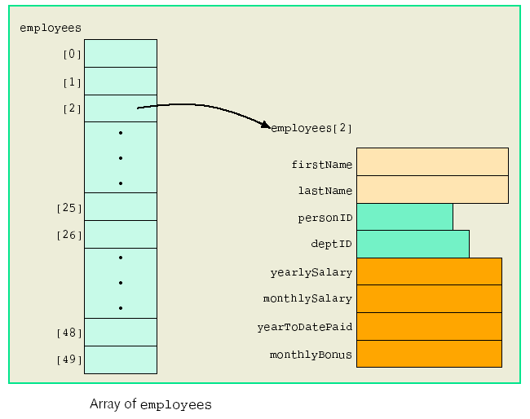
employeeType employee[50]; // struct variable
declaration

Slide 18
Structs in arrays (continue)
Consider the following statements:
// assign “IT999” to the dept ID of 1st employee
strcpy(employee[0].deptID, “IT999”);
// increase the 20th employee monthly salary by 1200
employee[19].monthlySalary += 1200.00;
// assign year to date paid of 84500.00 to the last employee
employee[49].yearToDatePaid = 84500.00;
// user inputs monthly bonus for all 50 employees
for ( i = 0 ; i < 50; i++ )
cin >> employee[i].monthlyBonus;
// display the 5th letter of first name of the 36th employee
cout << employee[35].firstName[4];

Slide 19
Structs in structs
Struct variable is found/nested in struct variable
struct addressType {
char address1[20];
char address2[20];
char city[15];
char state[12];
int zip;
}
struct nameType {
char first[10];
char middle[10];
char last[10];
}
struct contactType {
char phone[15];
char cellphone[15];
char fax[12];
char pager[12];
char email[30];
}
struct dateType {
int month, day, year;
}

Slide 20
Structs in structs (continue)
After the employee’s name, address, contact and date are separated into subcategories, the new employee’s record is as below:
struct employeeType {
nameType name;
char empID[10];
addressType address;
dateType hireDate, quitDate;
contactType contact;
char deptID[10];
double salary;
}

Slide 21
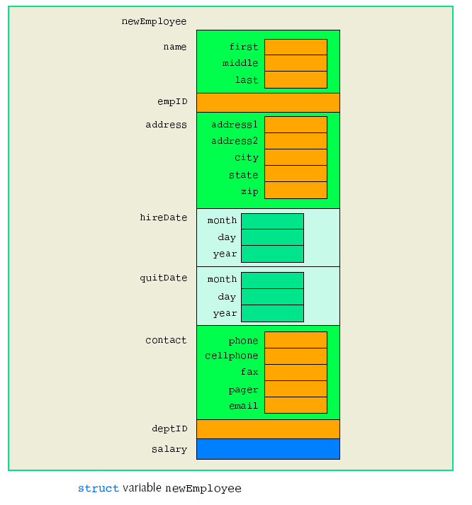
employeeType newEmployee; // struct variable
declaration

Slide 22
Structs in structs (continue)
Consider the following statements:
// assign “John” to the first name
strcpy(newEmployee.name.first, “John”);
// assign zip code 53300
newEmployee.address.zip = 53300;
// read from user the month of hiredate
cin >> newEmployee.hireDate.month;
// display the email
cout << newEmployee.contact.email;

